Slide 1
Simple Online Banker App
Group 7
Brittany Kapral
Yukyung Jung
Luke rhodes

Slide 2
Revision History Table
Revision # | Date | Description | Name
1 | 12/15/2017 | Initiate How-To. | Brittany
2 | 12/15/2017 | Added how to install the web application. | Yukyung
3 | 12/15/2017 | Syntax and formatting changes. Slight edits to increase usability. Made adjustments based on code adjustments. | Luke

Slide 3
Web Application Server Requirements
Webserver Engines (Apache, Nignx, IIS)
Tomcat Server (Above 8.0)
MySQL Server (or MariaDB)
Netbeans 8.2

Slide 4
Install SBOnline Web Application
Extract the ”Sbonline” zip file
Ensure you have MySQL and Tomcat/Apache running. Xampp is an easy way to ensure this.
In MySQL command line tool or PHPMyAdmin to execute the “Sbonline” SQL script file to create the database.
In ”Sbonline” folder, there is web sub-directory.
Copy all the files and folders under web directory to Tomcat Webapp folder to deploy the Web Application
Open project in Netbean
Build with Netbean
Source Packages > bank > DBUtil.java: make sure you have an authorized user
and password entered here. Either adjust to yours or add sbuser to your database.

Slide 5
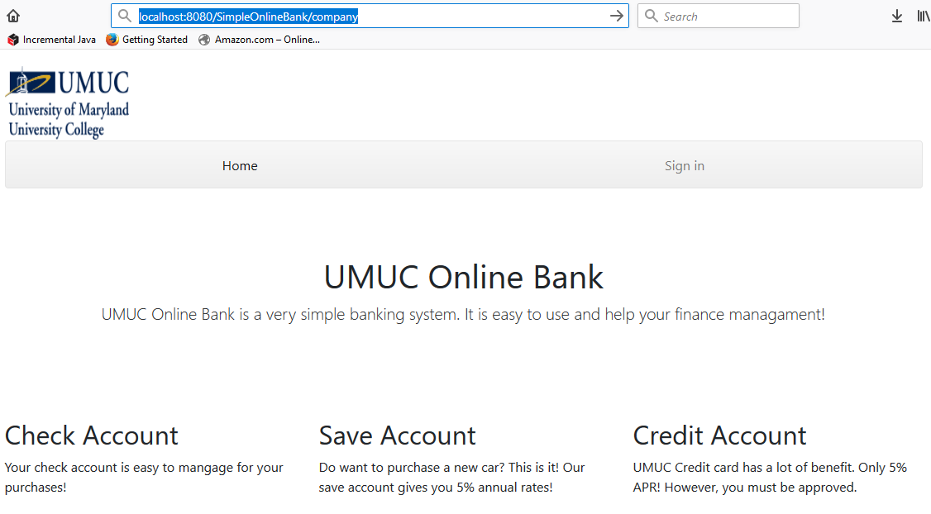
Company Page
After running the project you need to add company in the address bar after address.
Ex: localhost8080/SimpleOnlineBank/company

Slide 6
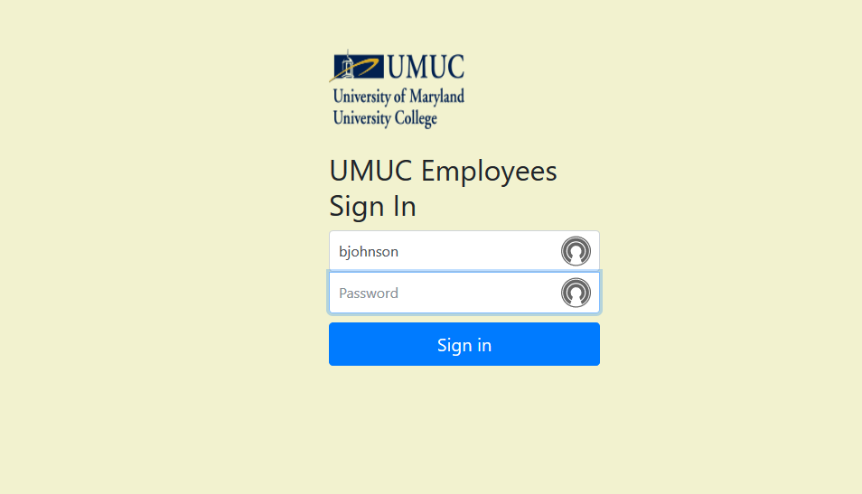
Banker/Administrator Login Page
In order to access the bankers page you will need to login in with the bankers username and password.
Test username: bjohnson
Test password: blue

Slide 7
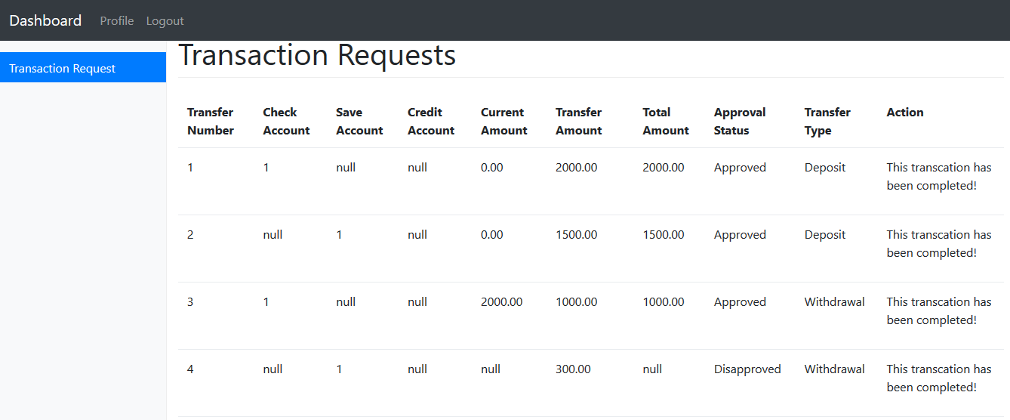
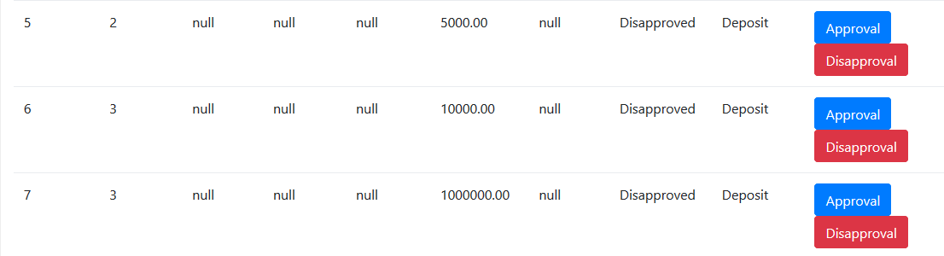
Banker Main Page
Login page for banker, viewing transaction requests. You can either approve or deny each transaction.

Slide 8
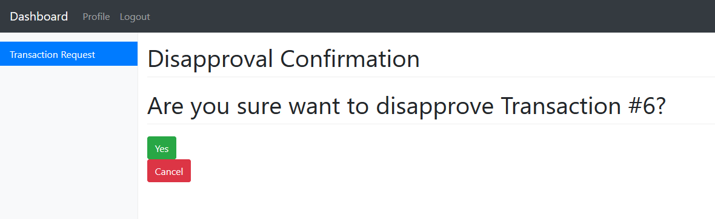
Banker Disapproval Page
If you click the disapproval button it will take you here. If you click “Yes” the table will be updated and you will go back to banker main page.
If you click “No” you will go back to banker main page.

Slide 9
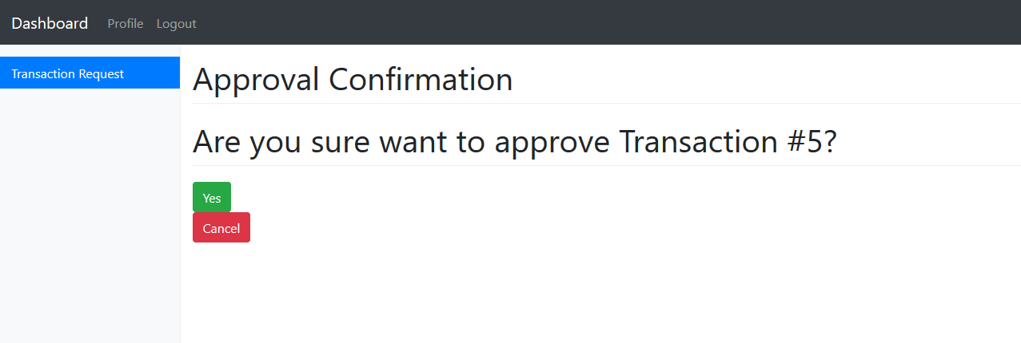
Banker Approval Page
If you click the approval button it will take you here. If you click “Yes” the table will be updated and you will go back to banker main page.
If you click “No” you will go back to banker main page.

Slide 10
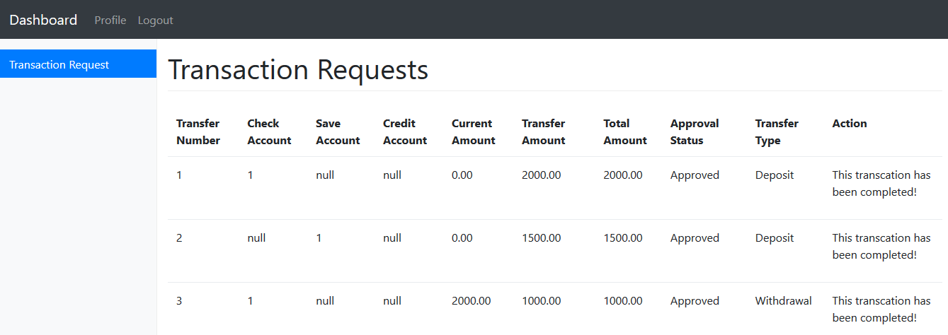
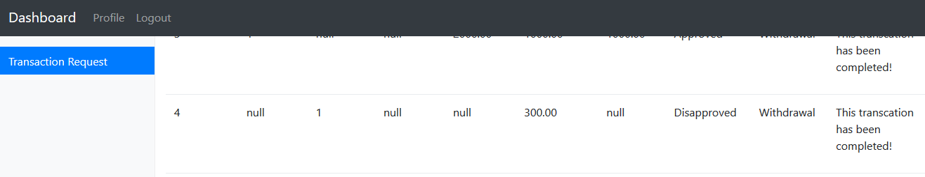
Banker Transaction approval/denial
After approving or denying transaction the status will be updated in the “Approval Status” field.

Slide 11
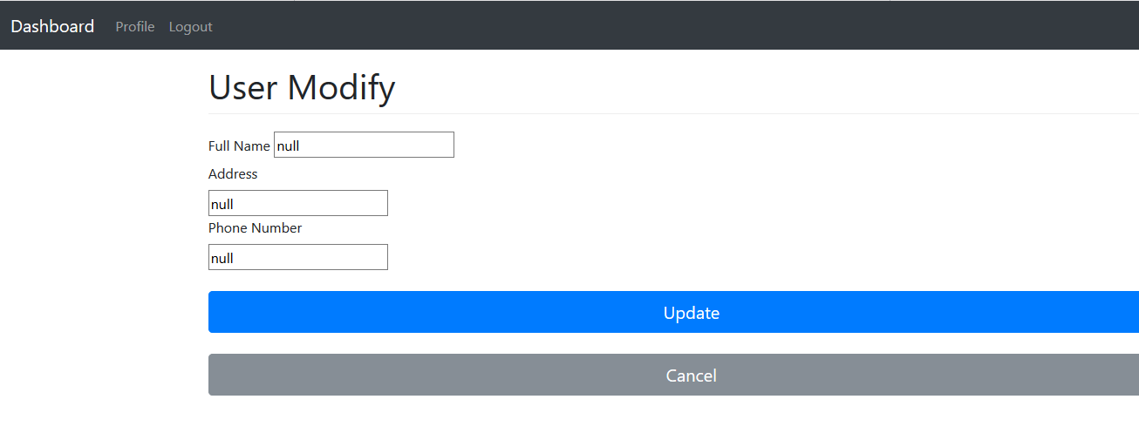
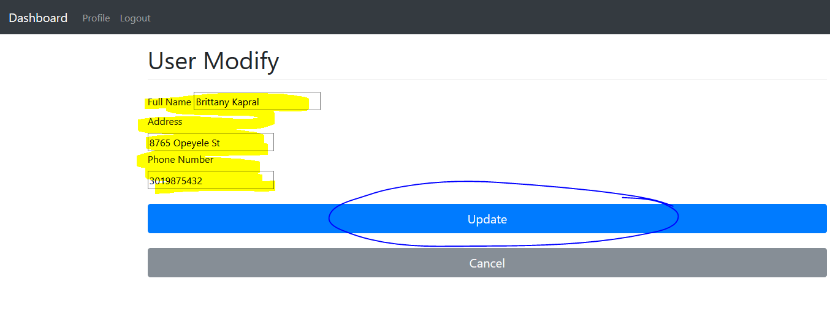
Banker Information Modifier
Banker info modifier
Click “Profile” located at the top of webpage.
Enter in data.
Click “Update” button.

Slide 12
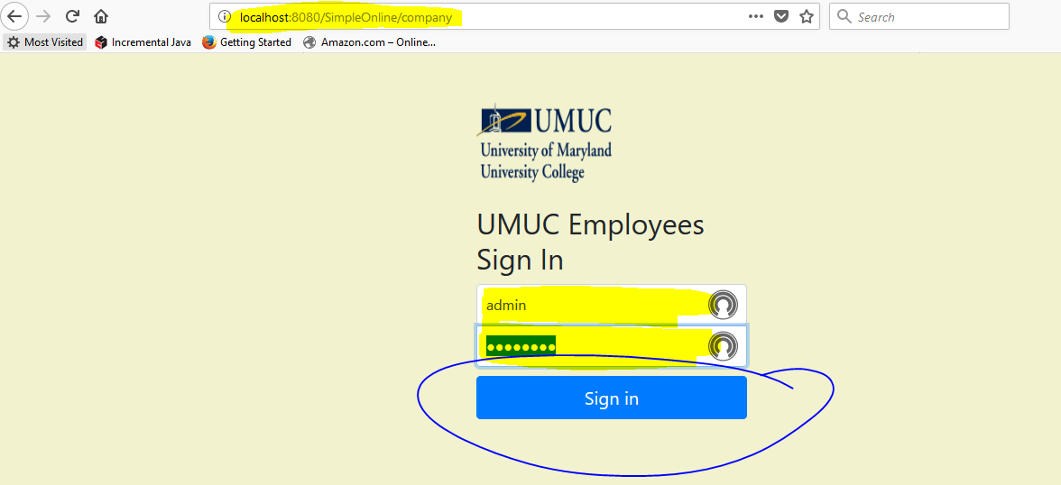
Administrator Page
Enter in localhost:8080/SimpleOnline/company in web browser.
Enter in admin username and password.
Test username: bkapral
Test password: blue1221
Click “Sign in” button.

Slide 13
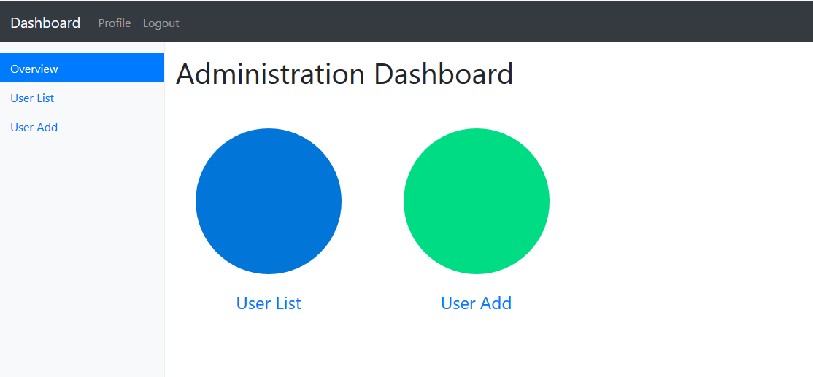
Administrator Home page
After logging in the “Administrator Dashboard” will be displayed.

Slide 14
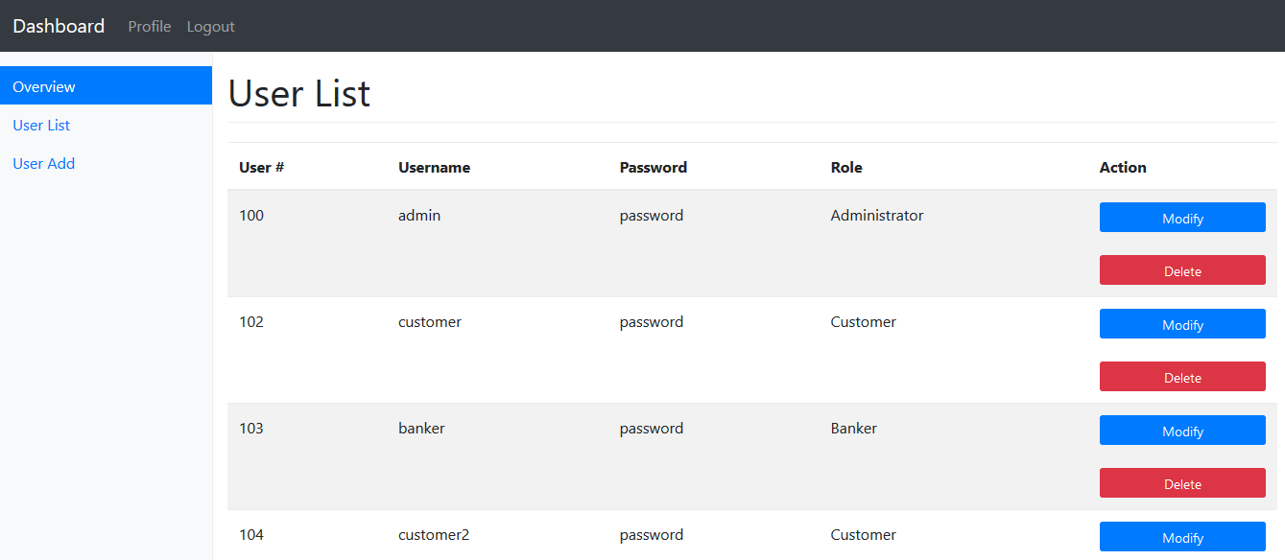
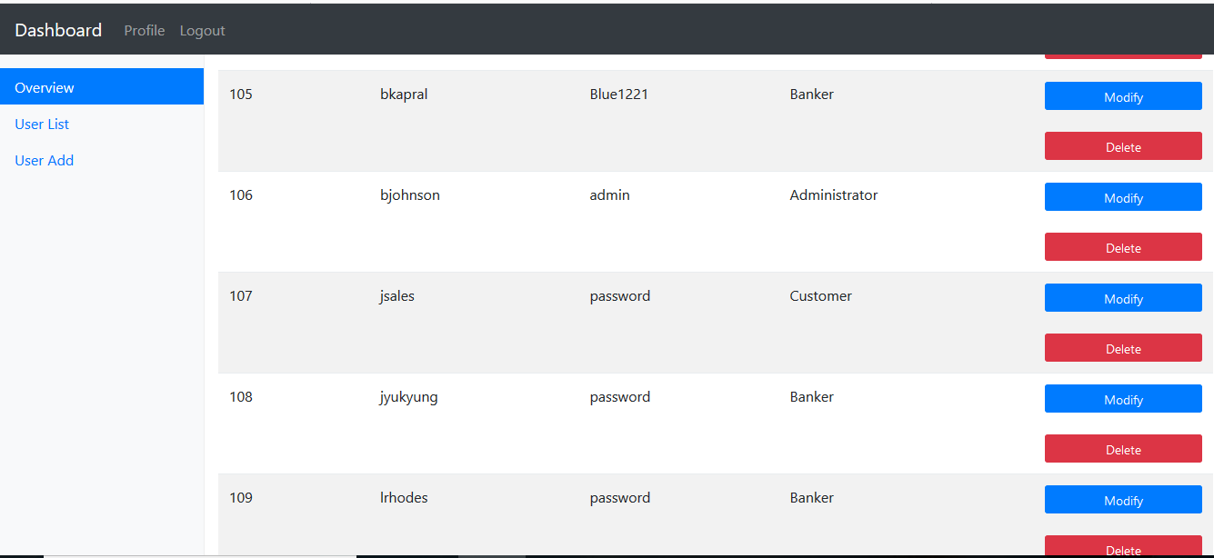
Administrator User List
Click “User List”
You will be able to view all users that have access to Bankers App.
You can either modify or delete user.

Slide 15
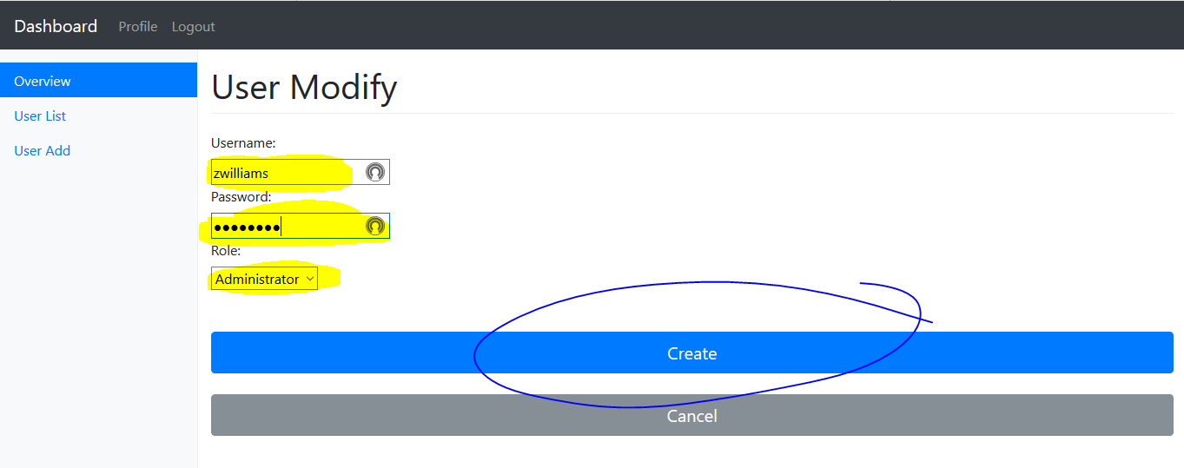
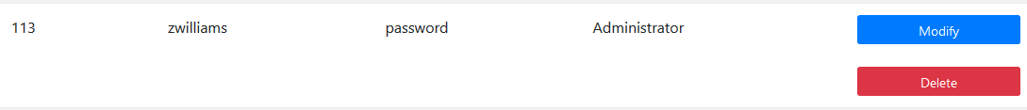
Admin Create User Page - Admin
Click the “User Add” button.
“User Modify” web form will immediately open.
Enter user data in form and make sure you select the proper role. In this case I have selected the “Administrator role”.
Click “Create” if the entered info is correct.
New user will be added to user data table as shown in second screenshot.

Slide 16
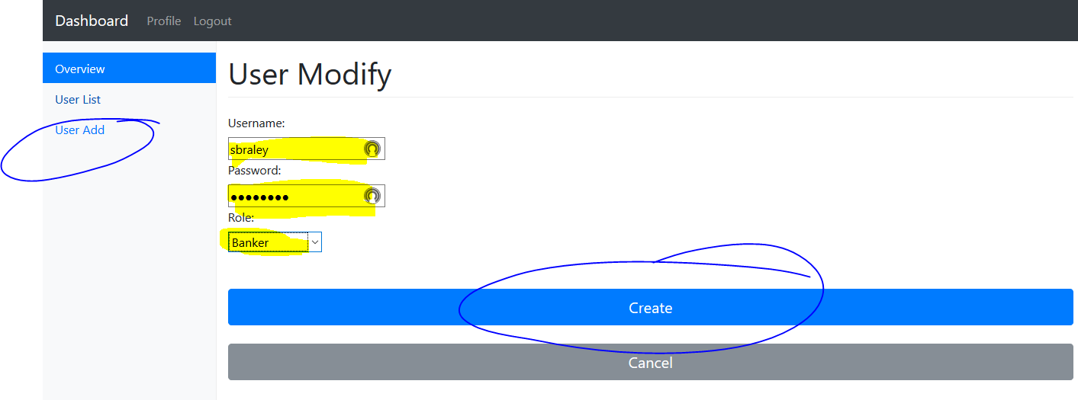
Admin Create User Page - Banker
Click the “User Add” button.
“User Modify” web form will immediately open.
Enter user data in form and make sure you select proper role. In this case I have selected the “Banker” role.
Click “Create” if the entered info is correct.
New user will be added to user data table as shown in second screenshot.

Slide 17
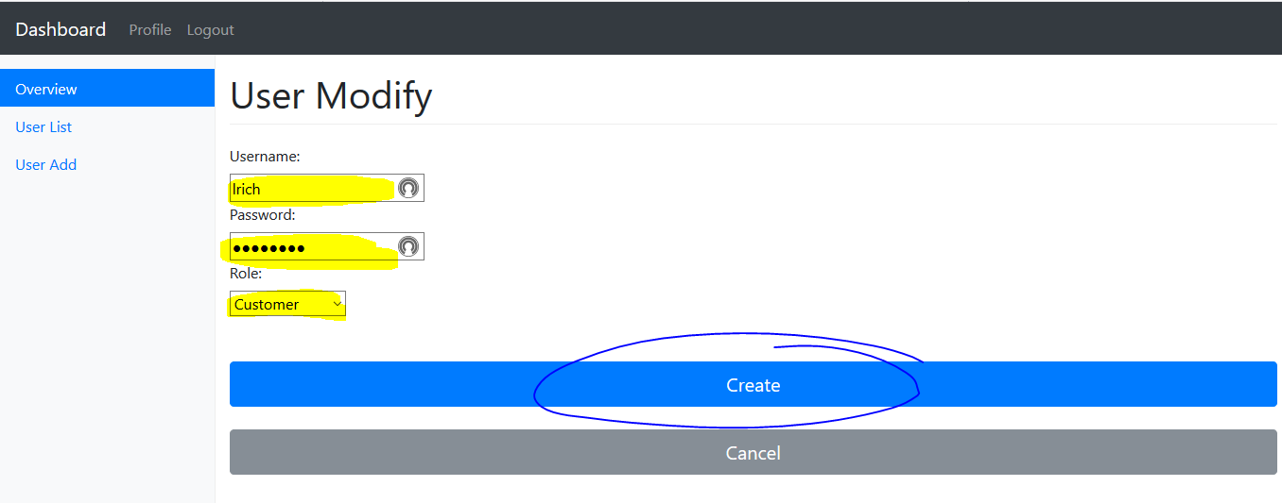
Admin Create User Page - Customer
Click the “User Add” button.
“User Modify” web form will immediately open.
Enter user data in form and make sure you select proper role. In this case I have selected the “Customer” role.
Click “Create” if the entered info is correct.
New user will be added to user data table.

Slide 18
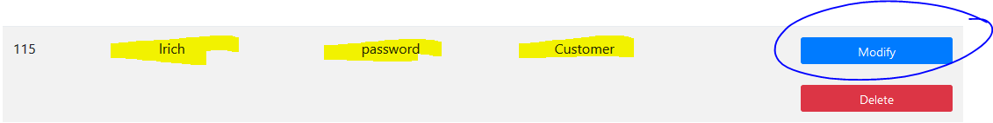
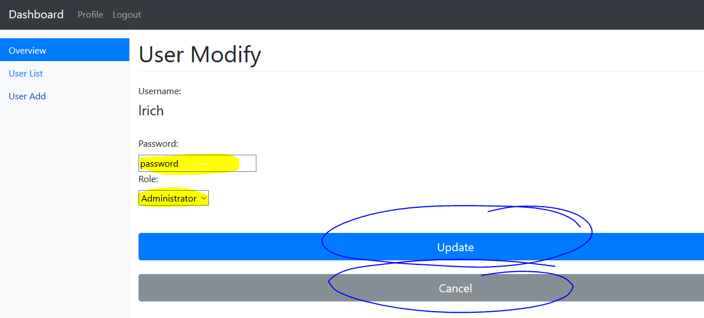
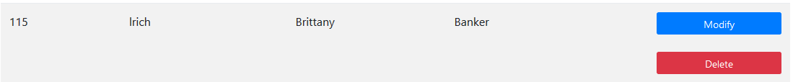
Admin Modifier Page
Click the “Modify” button next to a user on the User List page.
“User Modify” web form will immediately open.
You can modify users password and or role.
Click “Update” if the changes are accurate.

Slide 19
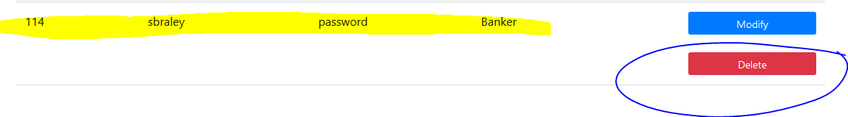
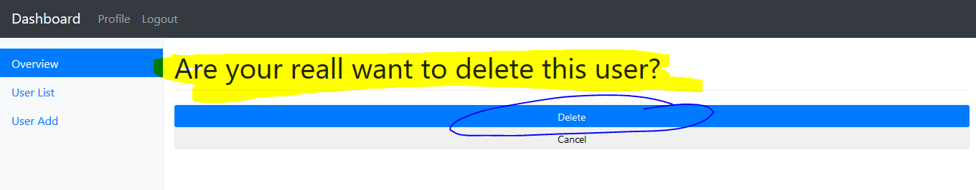
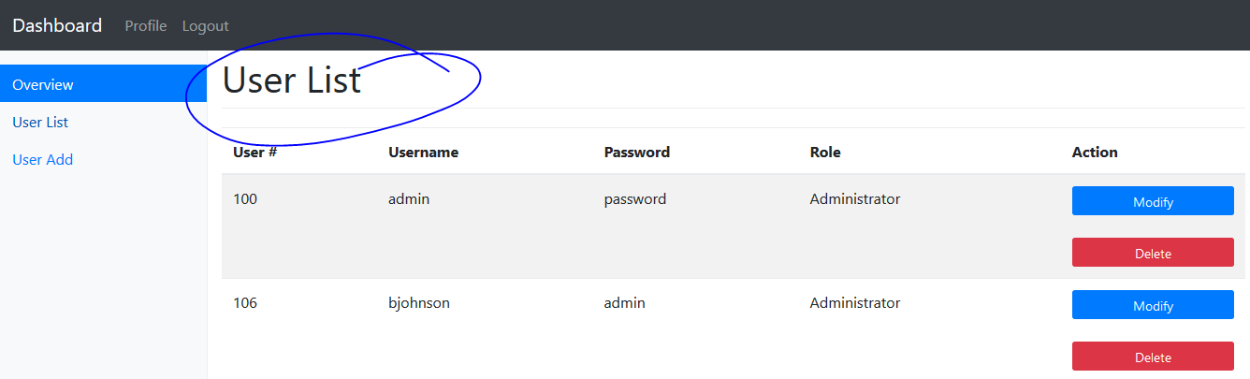
Administrator Page - Delete
You may also delete a user from the user list by clicking the “Delete” button.
As second prompt will allow you to either click the “Delete” button or the “Cancel” button.
If you click the delete button the user will be deleted from the “User List” on screen and also “User” table. Their user will also be removed from the bank table.
If you select the “Cancel” button this form will close and the webpage will bring you back to the “User List” web form.

Slide 20
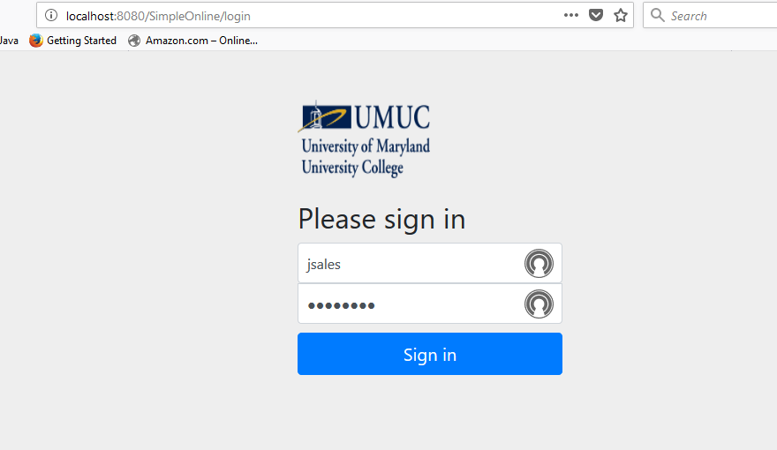
Customer Login Screen
This is the customer login screen.
In order to login into the customer’s webpage an “Admin” user would have to create customer’s account.
Test username: jsales
Test password: purple

Slide 21
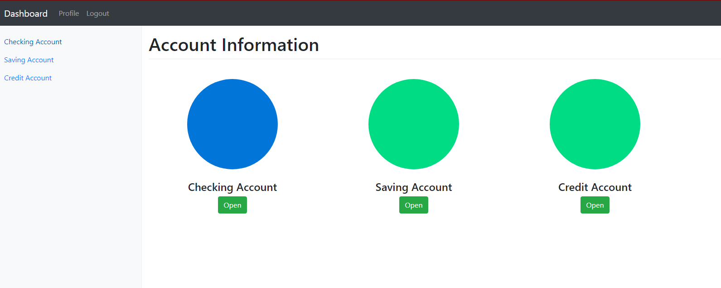
Customer Dashboard
When logging into to bankers application as a customer for the first time you will see the customer dashboard.
In order to open “Checking”, “Saving”, or “Credit” account click the open button(s).

Slide 22
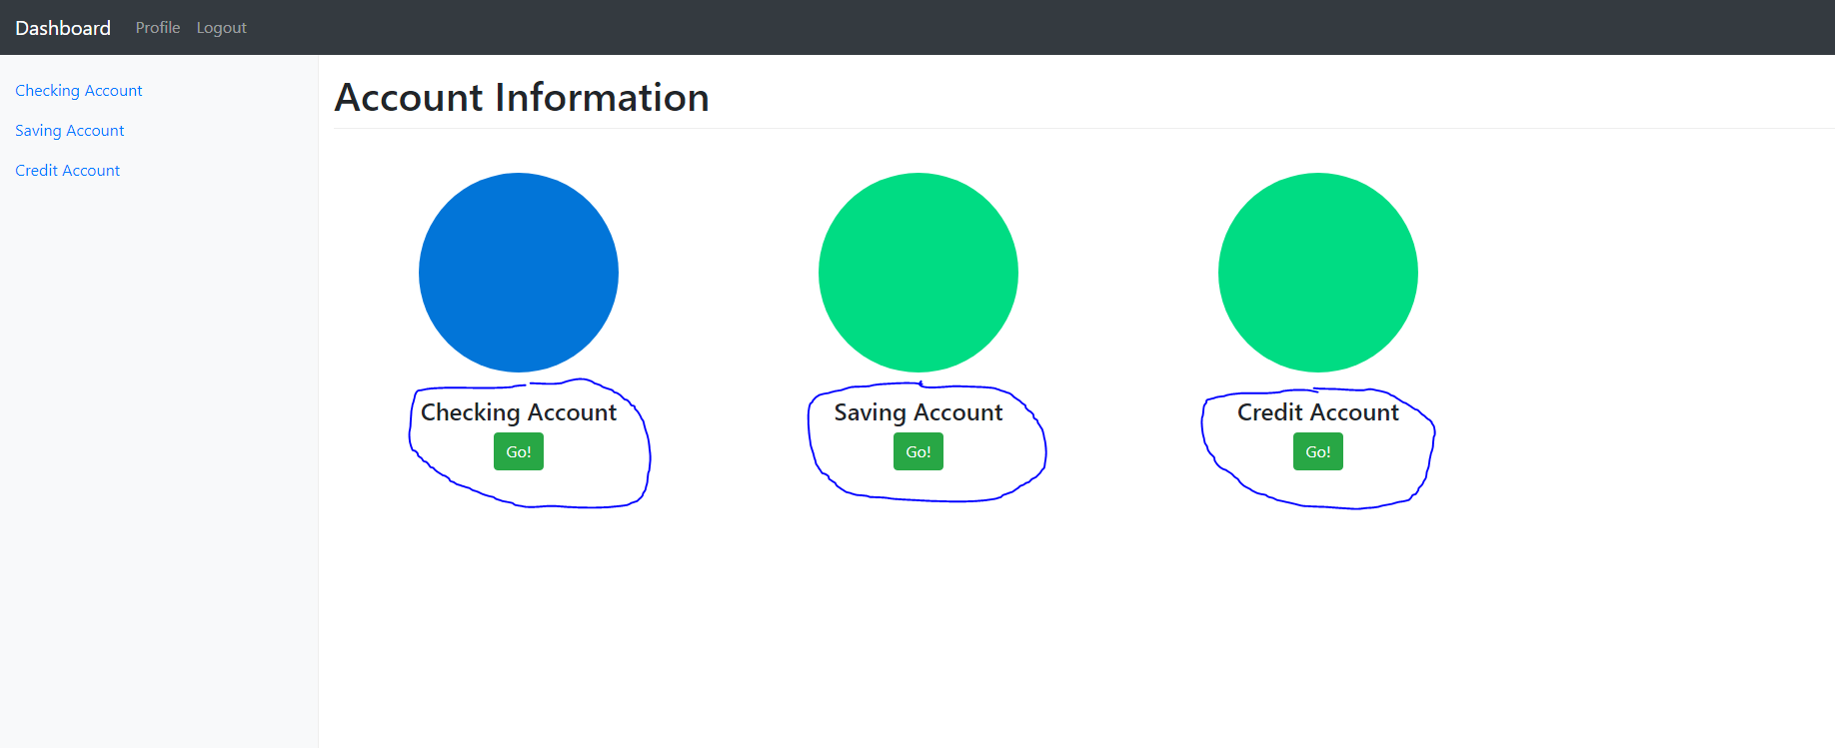
Customer’s Saving & Checking Acct.
After opening “Checking”, “Savings”, or “Credit” account the “Open” buttons will update to display as “Go”.

Slide 23

Create Transactions
“Checking Account”, “Saving Account”, and “Credit Account” links are located on the left side of webpage as seen in screen shot.

Slide 24
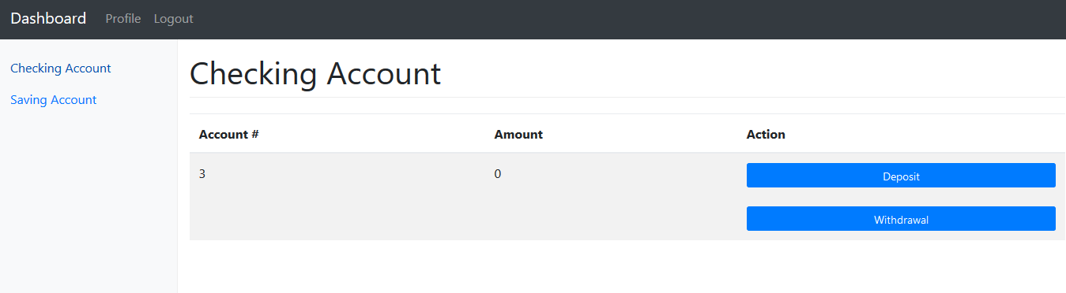
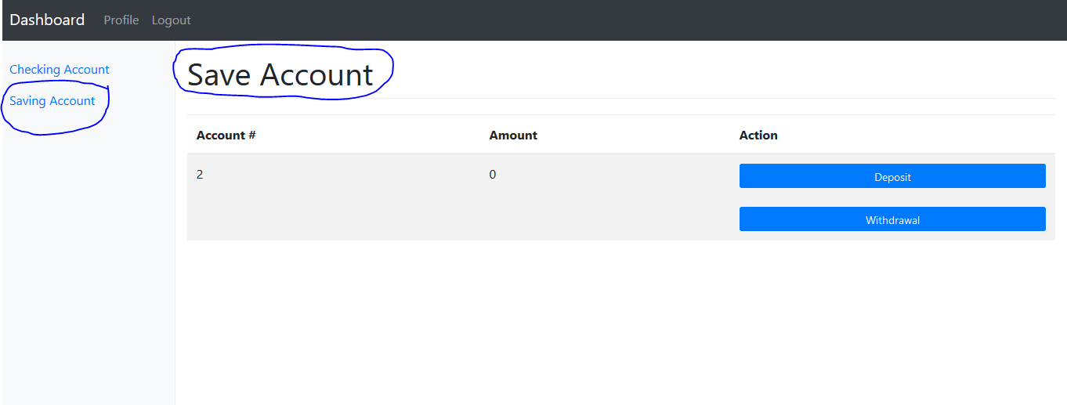
Customer Checking/Saving Account
You can click either “Checking Account”, “Saving Account”, or “Credit Account”.
You will be able to view the Account#, Amount, and Action.
The “Checking Account”, “Saving Account”, and “Credit Account” forms look exactly the same except wording to each account.

Slide 25
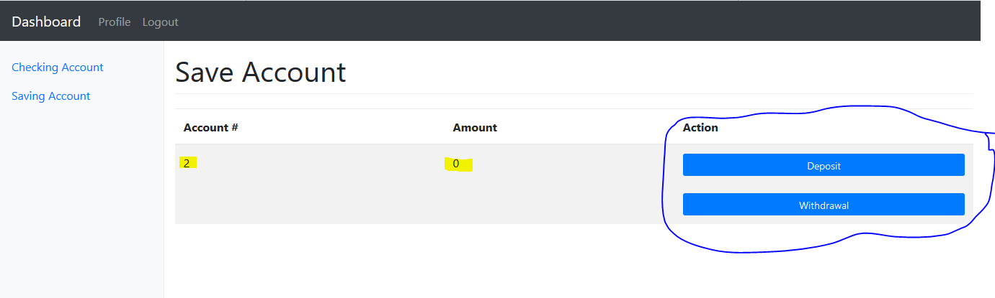
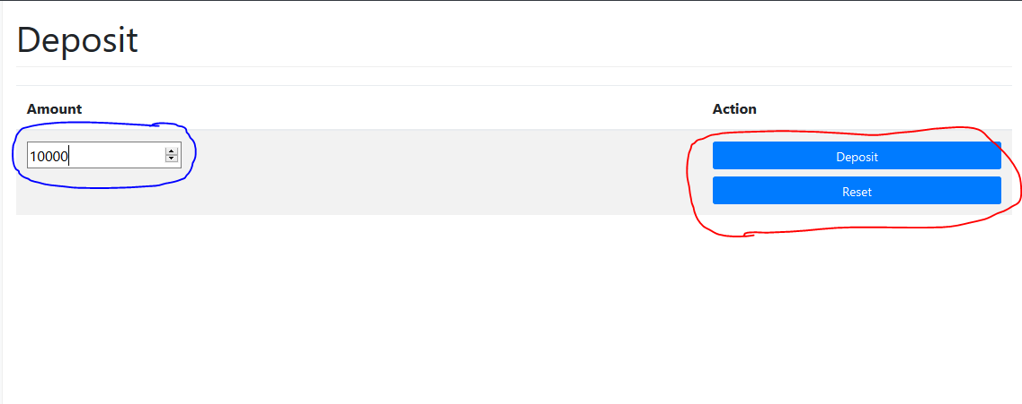
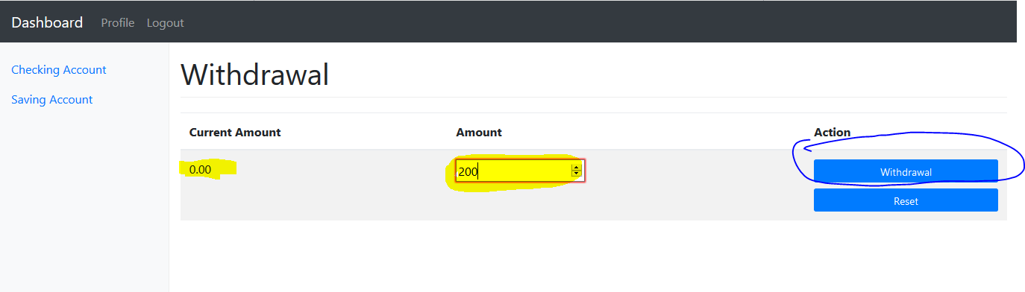
Customer Withdrawal & Deposit section
“Banker” has to approve any transaction you request.
Make deposit
Click “Deposit”.
A deposit form will open(2nd screenshot).
Enter in cash amount.
Click “Deposit” button and transaction complete.
Make withdrawal
Click “Withdrawal” button
A withdrawal form will open(3rd Screenshot).
Enter in withdrawal amount (amount can not be more than the current balance.)
Click “Withdrawal” button and transaction complete.

Slide 26
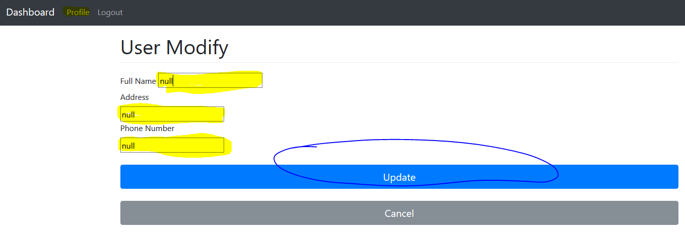
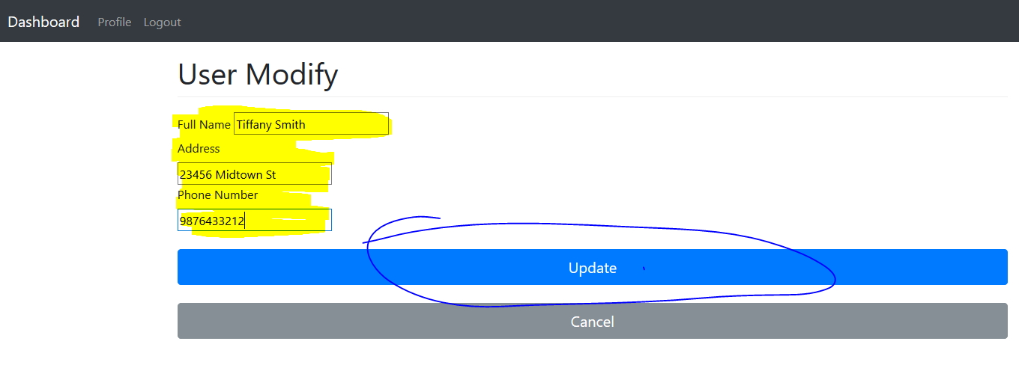
Customer edit Profile
Click “Profile” link next to the dashboard.
Enter in data (Full name, Address, Phone Number).
Click “Update” button.

